Slide 1

VOICE ACTIVITY DETECTION IN NOISE USING DEEP LEARNING
MMI 705 – Current Trends in Music Engineering I (1st December 2020)
Jigar Rajpopat

Slide 2
Workflow
For both training and test datasets:
Clean audio files (detectSpeech)
Concatenate speech signals (silence of max 2s in between)
Speech signal + Noise = Noisy Signal (low SNR)
Baseline: Speech-only signal
Extract features
Training (and validation):
Train network using these features
Testing:
Compare network’s accuracy to the VAD baseline

Slide 3

Audio examples
Speech
Combining speech samples
Noise
Training signal

Slide 4
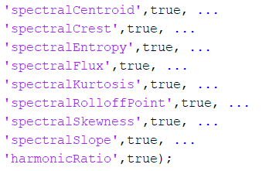
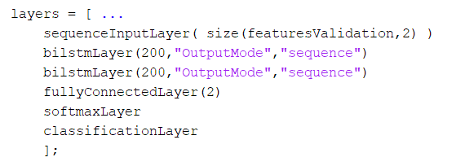
Features ->
Network ->

Slide 5
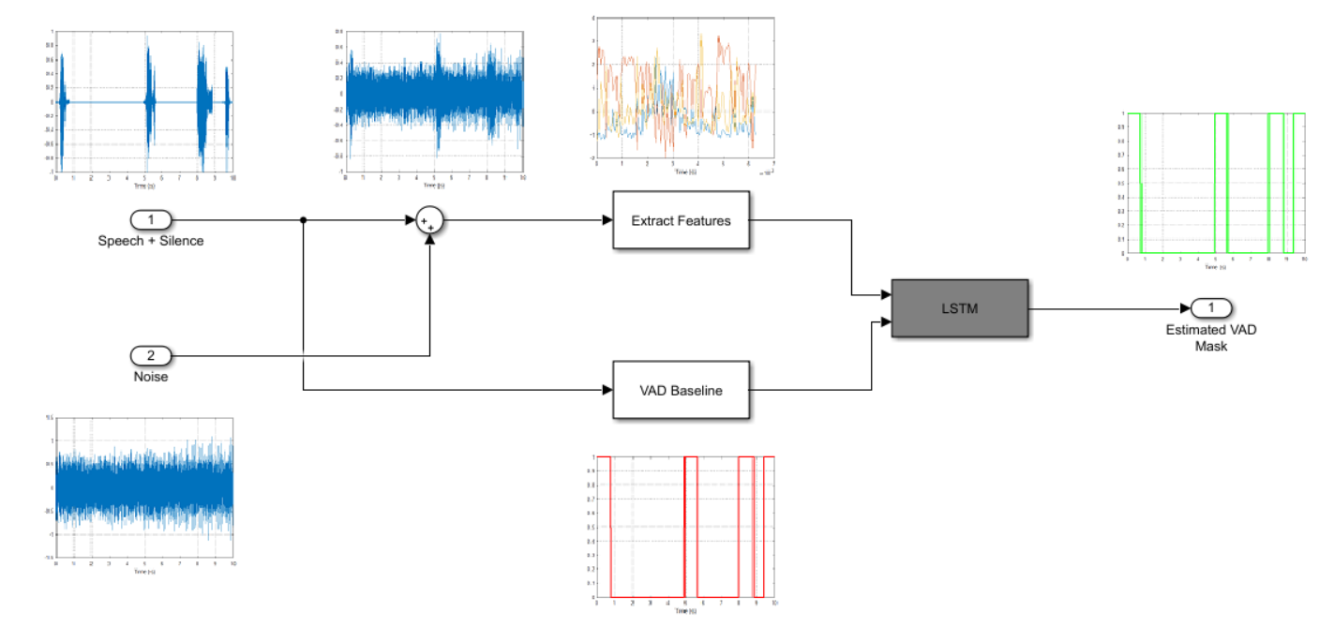
Training process in a nutshell

Slide 6
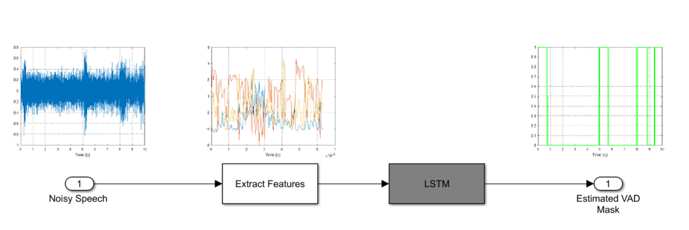
Testing process in a nutshell

Slide 7
ORIGINAL SETTINGS
REDUCING BATCH SIZE
REMOVING ONE BI-LSTM LAYER
ADDING MFCC AS FEATURE

Slide 8
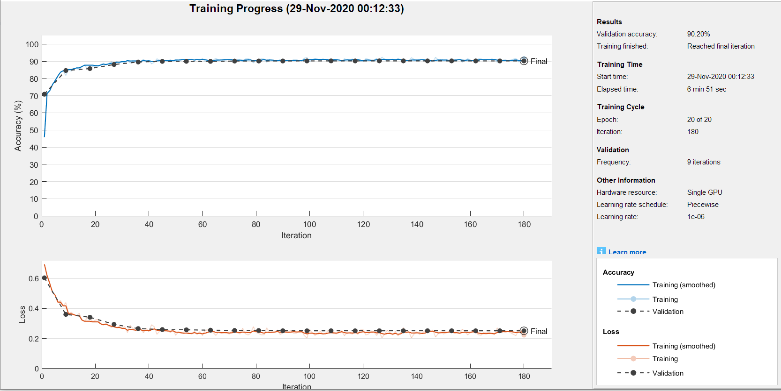
Original setting

Slide 9
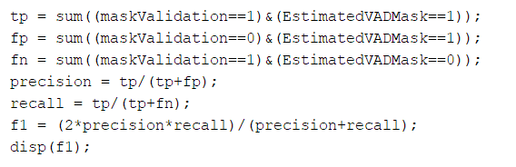
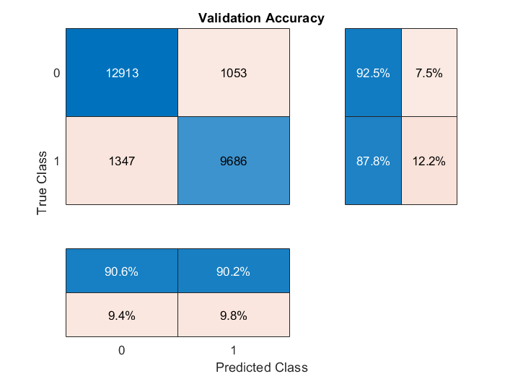
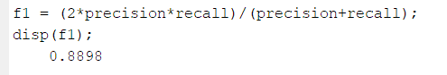
Original setting
F1 score calculation (handles class imbalance)

Slide 10
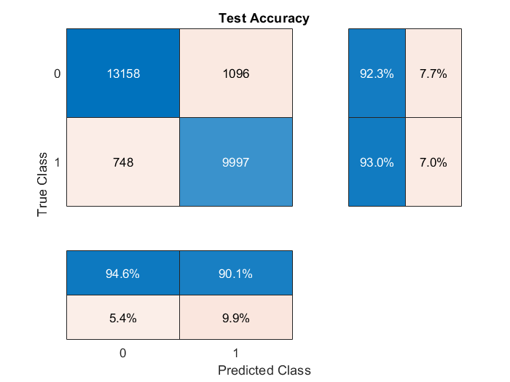
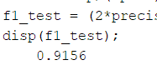
Original setting

Slide 11
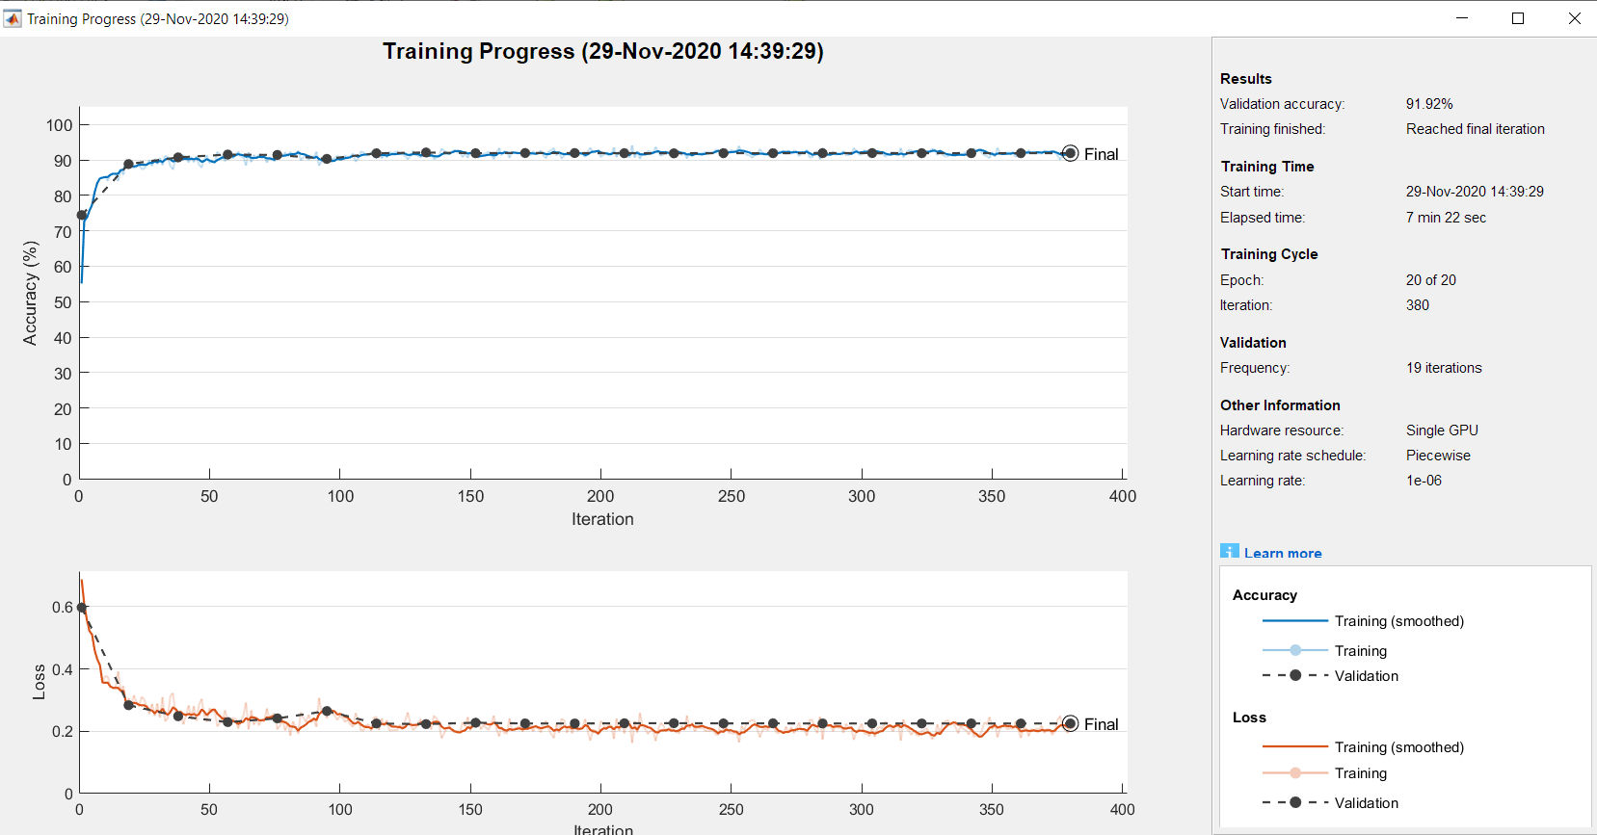
1st change: Reducing batch size (64 to 32)

Slide 12

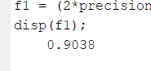
1st change: Reducing batch size (64 to 32)

Slide 13

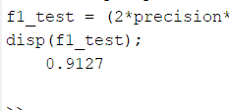
1st change: Reducing batch size (64 to 32)

Slide 14
1st change: Reducing batch size (64 to 32)
Inference:
Takes slightly longer to train (19 iterations per epoch instead of 9)
Slightly better accuracy
Presumably, some overfitting from iterations 80-90 (loss increases)

Slide 15
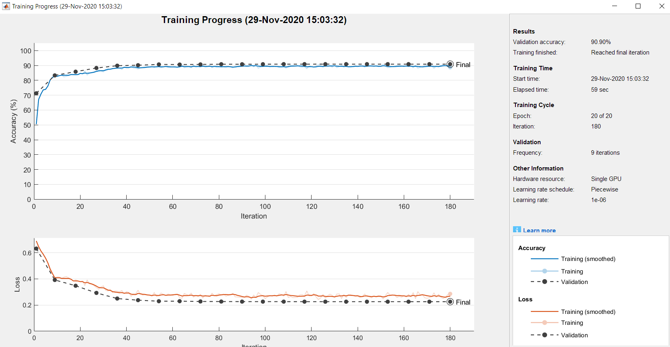
2nd change: Remove one BI-LSTM layer

Slide 16
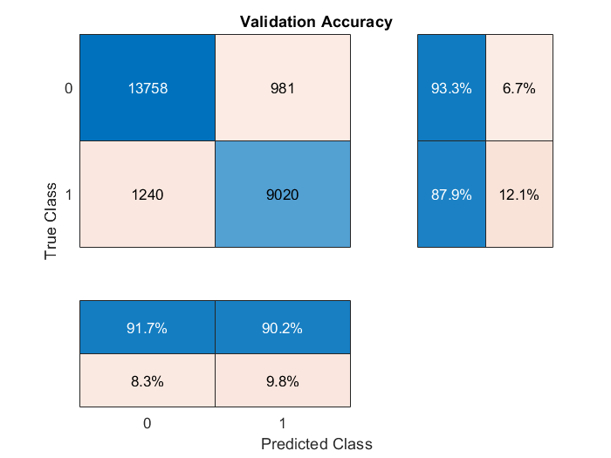
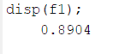
2nd change: Remove one BI-LSTM layer

Slide 17

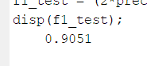
2nd change: Remove one BI-LSTM layer

Slide 18
2nd change: Remove one BI-LSTM layer
Inference:
Takes significantly less time to train (59 secs)
Slightly worse accuracy, but maybe still acceptable to start with

Slide 19
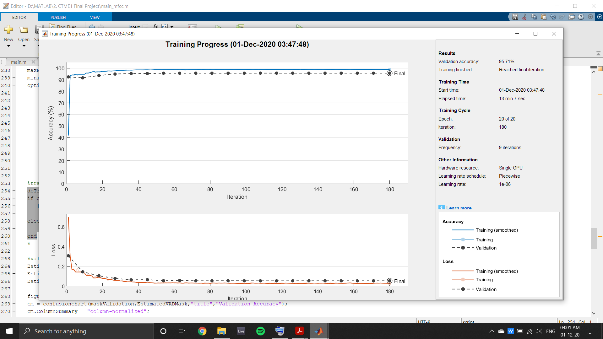
3rd change: Adding MFCC as feature

Slide 20
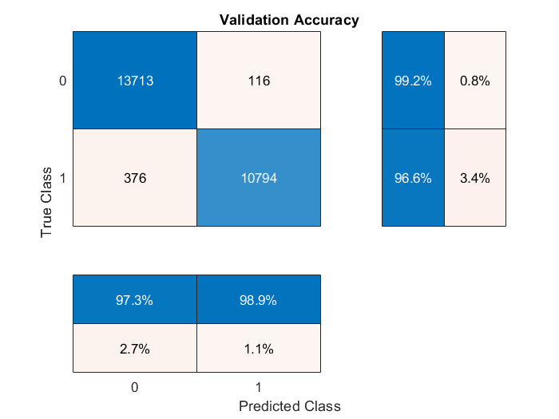
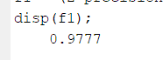
3rd change: Adding MFCC as feature

Slide 21
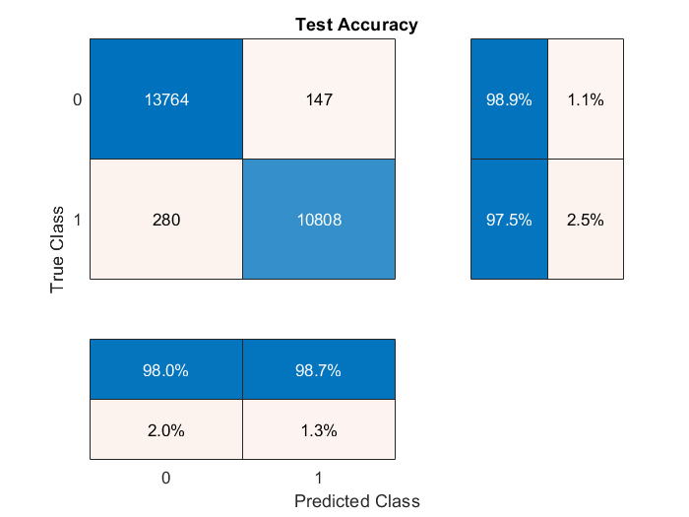
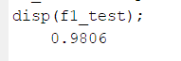
3rd change: Adding MFCC as feature
MFCC FTW

Slide 22
3rd change: Adding MFCC as feature
Inference:
Takes significantly more time to train (12 more features for each epoch)
Way better accuracy! (at the cost of time/system resources)

Slide 23
THANK YOU!

